Slide 1
DISJOINT-SET DATA STRUCTURE: A Short Introduction
Ramoni ADEOGUN, PhD
Assistant Professor – Machine Learning and AI for Wireless Communications
Department of Electronic Systems, Aalborg University, DK
Email: ra@es.aau.dk

Slide 2
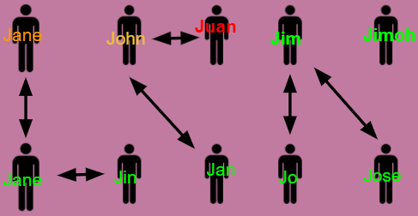
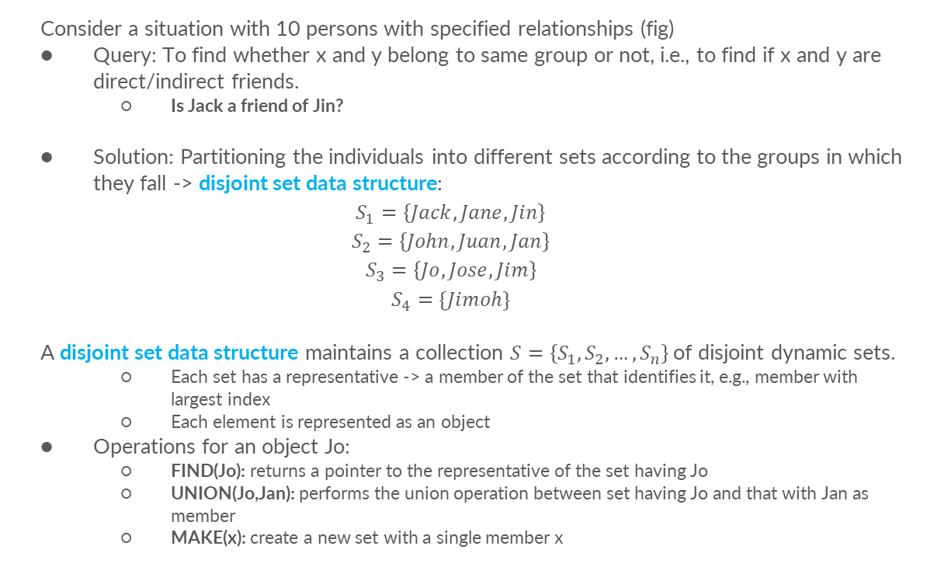
Introduction
Consider a situation with 10 persons with specified relationships (fig)
Query: To find whether x and y belong to same group or not, i.e., to find if x and y are direct/indirect friends.
Is Jack a friend of Jin?
Solution: Partitioning the individuals into different sets according to the groups in which they fall -> disjoint set data structure:
$$S_{1}=\left\{Jack, Jane, Jin\right\}$$
$$S_{2}=\left\{John, Juan, Jan\right\}$$
$$S_{3}=\left\{Jo, Jose, Jim\right\}$$
$$S_{4}=\{Jimoh\}$$
A disjoint set data structure maintains a collection $S=\left\{S_{1},S_{2},…,S_{n}\right\}$of disjoint dynamic sets.
Each set has a representative -> a member of the set that identifies it, e.g., member with largest index
Each element is represented as an object
Operations for an object Jo:
FIND(Jo): returns a pointer to the representative of the set having Jo
UNION(Jo,Jan): performs the union operation between set having Jo and that with Jan as member
MAKE(x): create a new set with a single member x
Is Jack a friend of Jin?
If representatives of the sets containing Jack and Jin are same, then they are friends.

Slide 3
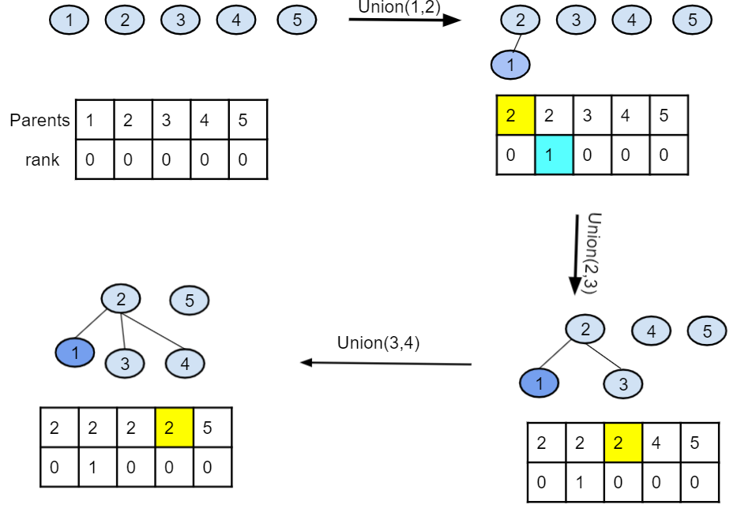
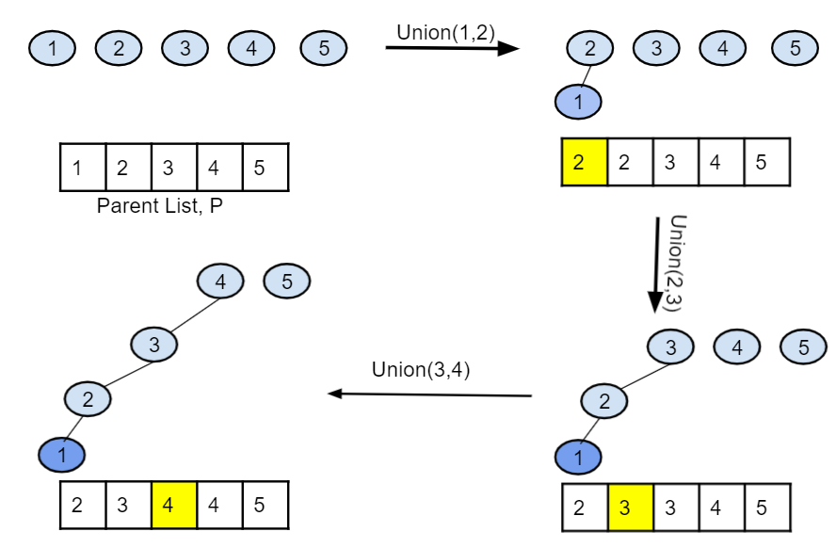
Set Operations– Union by Rank
Union by Rank
Naïve Union
How about calling find(1) on this?
What happens when we call find(1)?

Slide 4
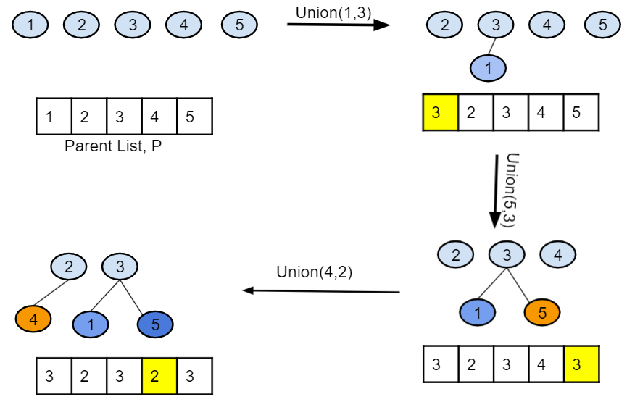
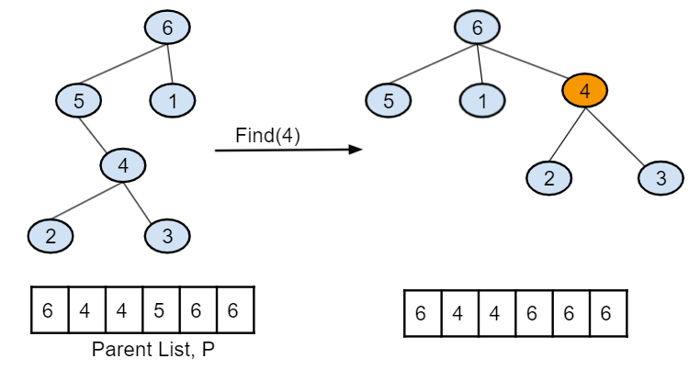
Set Operations – Union & Path Compression
Path compression

Slide 5
Conclusion
Disjoint set data structures are essential in several computer applications
Disjoint sets models non-overlapping partitioning of items into groups
Three basic operations are required for disjoint set data structures:
FIND -> which set does an item belong to?
UNION -> combine the items in two sets having specified members
MAKE -> Represent the sets as objects
Efficient techniques on disjoint set data structure include:
Union by rank
Path compression

